Slide 1
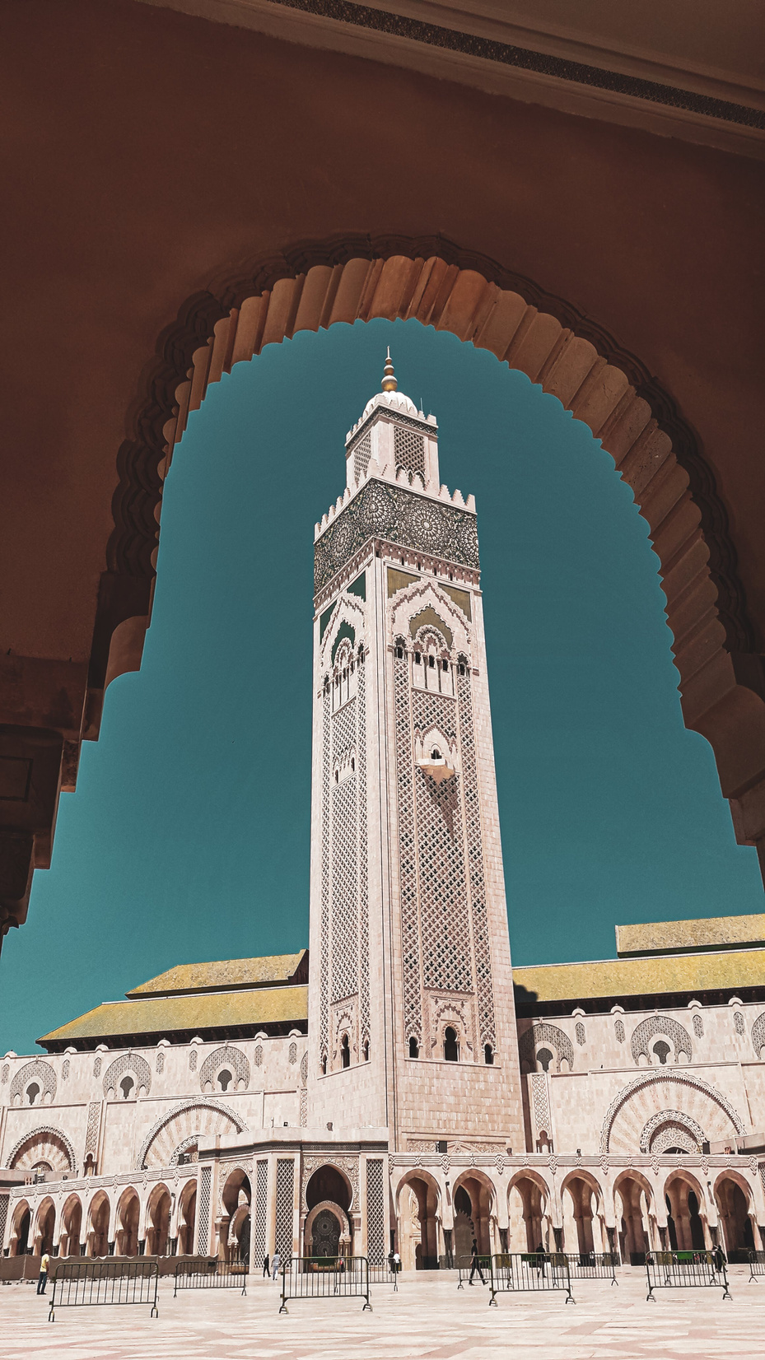
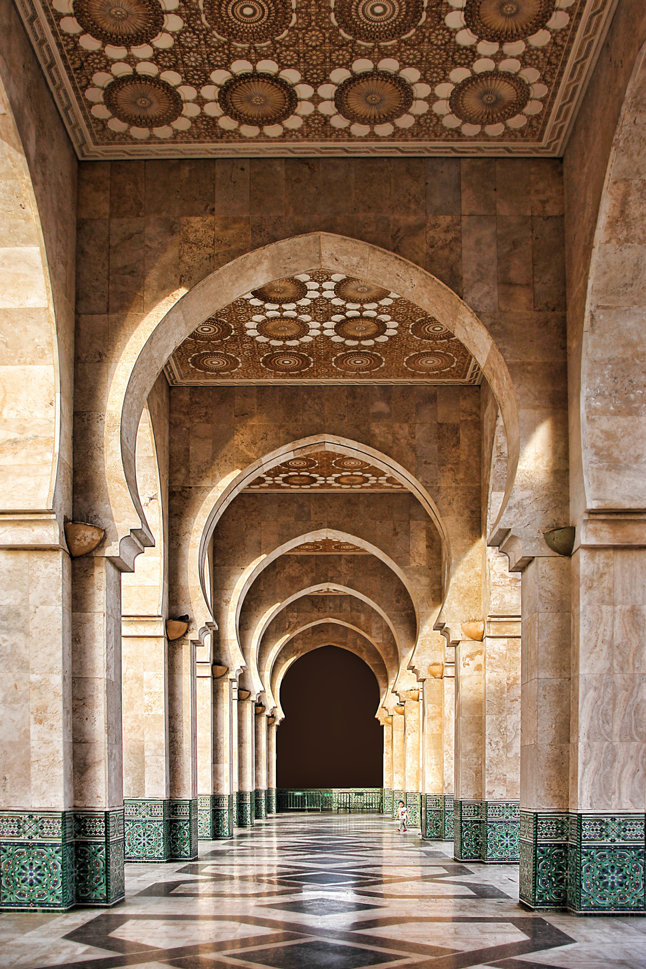





Morocco
SAFEr
Safety Transparence Collaboration
Hackathon: Fraud prevention for a secure future
Presented by: Salma EL BARBORI

Slide 2
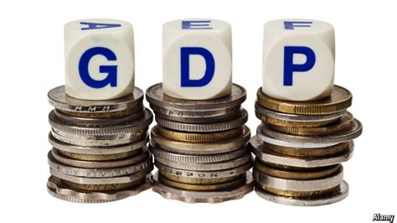
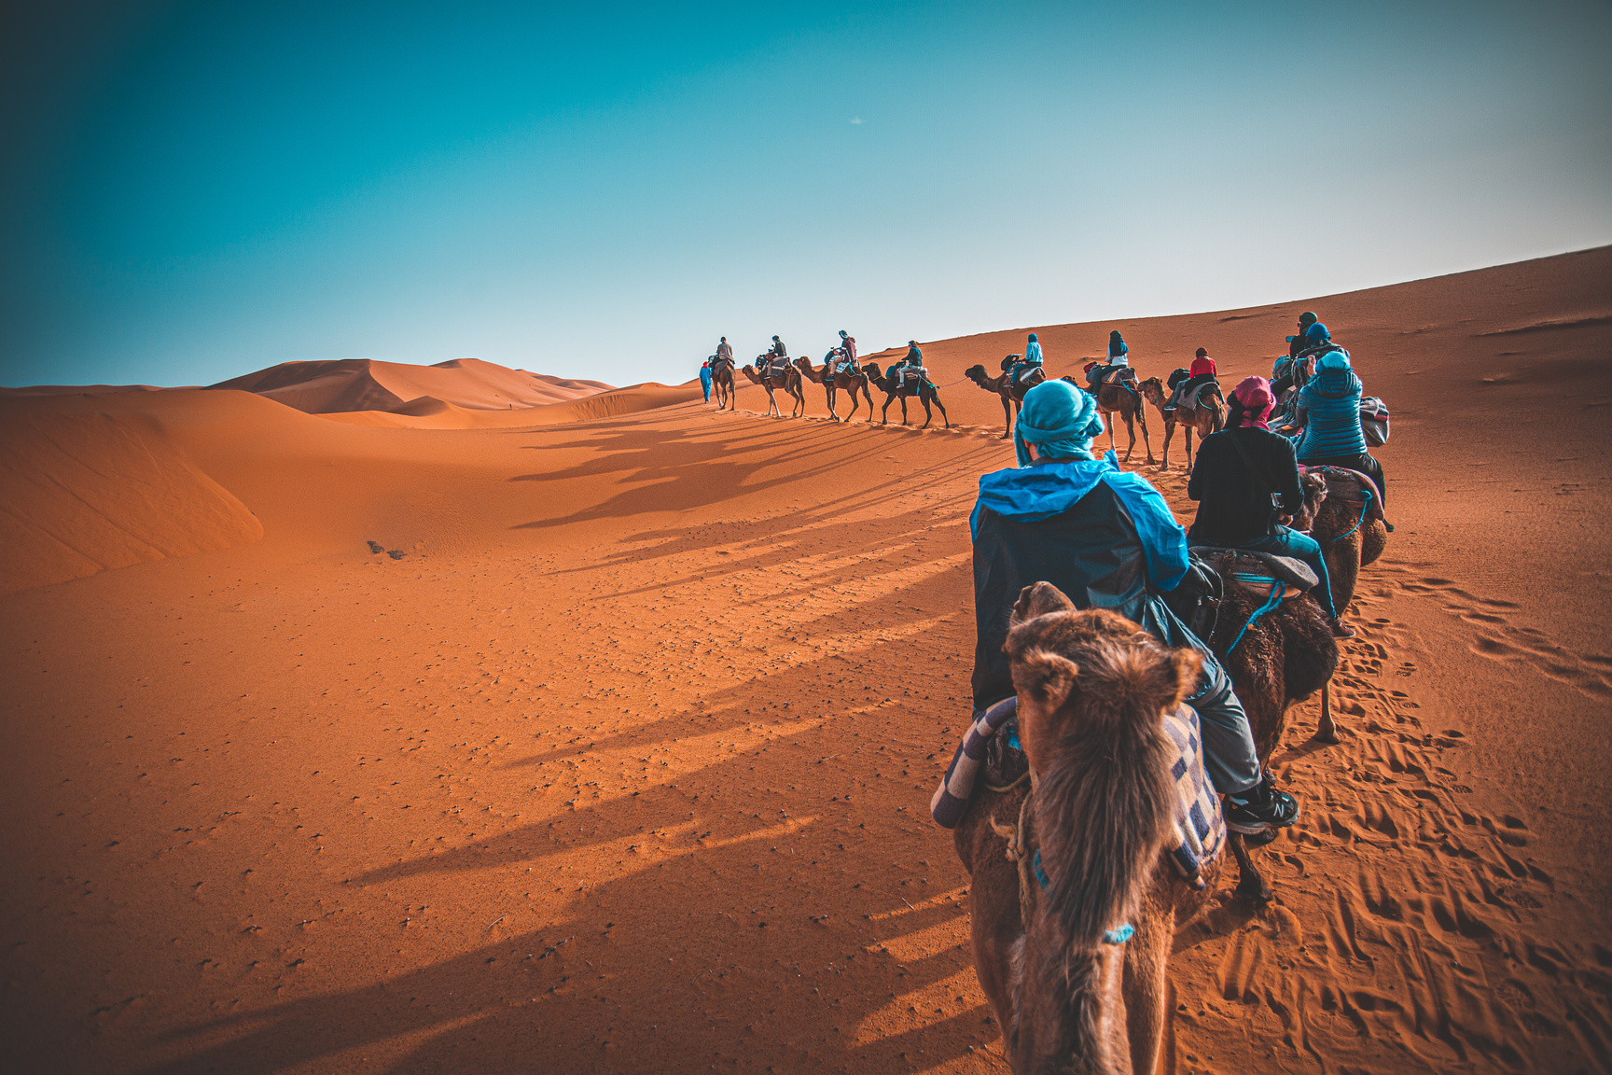
Impacts of tourism on Morocco’s Economy and development
Forecast an increase by 2.7% in 2023-2028
Employes 5% of the total employment in 2019

Slide 3
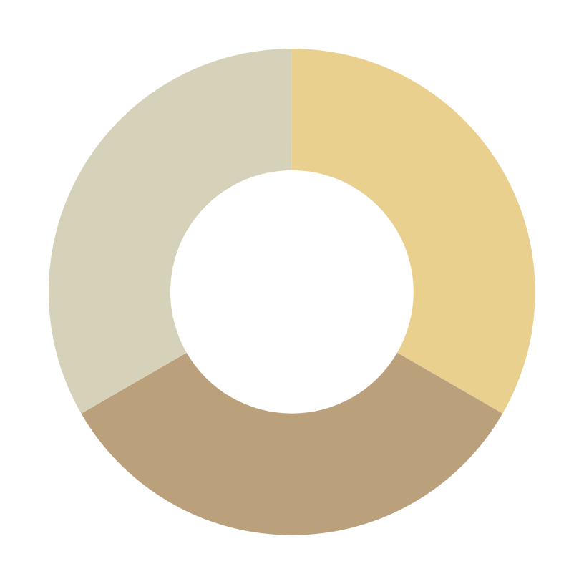
Challenges facing the sector of Tourism in 2024-2028
Aggressive selling
Biased recommendations
Scams in pricing

Slide 4
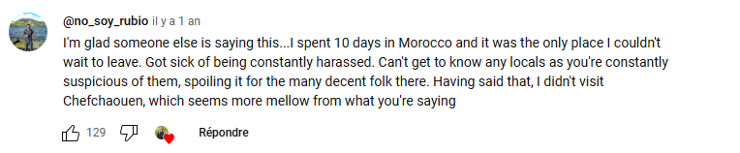
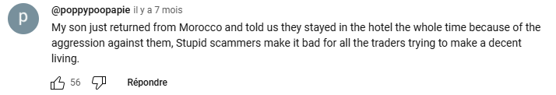
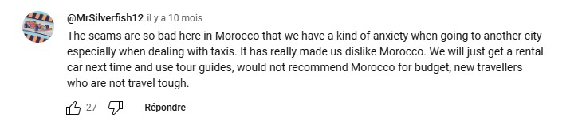
Impact of fraud on tourism

Slide 5
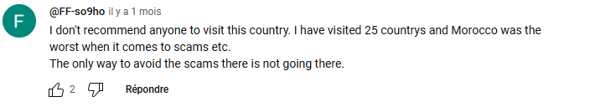
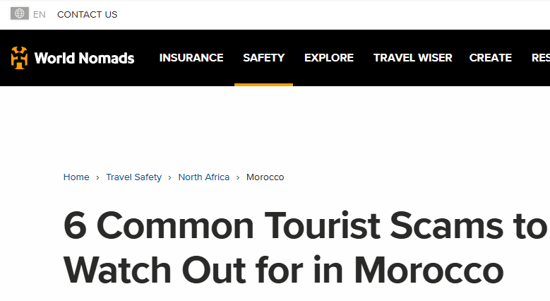
Impact of fraud on tourism

Slide 6
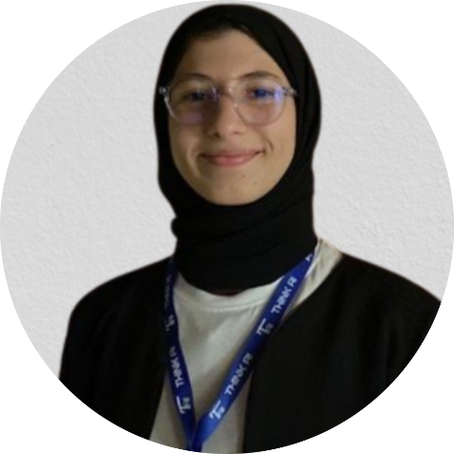
Who AM I?
I am Salma EL BARBORI a graduate student majoring in competitive and strategic intelligence, and currently doing my internship in AI and knowledge management at an international group.

Slide 7
Morocco SAFEr
Safety Transparence Collaboration
Our collaborative platform aims to enhance tourist security during their stay in Morocco, by preventing them from any type of fraud.. This leads to securing the future of tourism as a leading sector to Morocco’s competitiveness.

Slide 8
Morocco SAFEr
Safety Transparence Collaboration
Services
Recommendation system based on Trust worthy platforms(Trip Advisor)
A knowledge hub to exchange tips with travelers
AI personal assistant for pricing analyses

Slide 9

AI personal assistant for pricing analyses

Slide 10
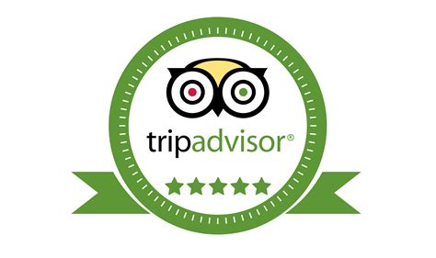
Recommendation system based on Trust-worthy platforms(TripAdvisor)

Slide 11

A knowledge hub to exchange tips with travelers

Slide 12

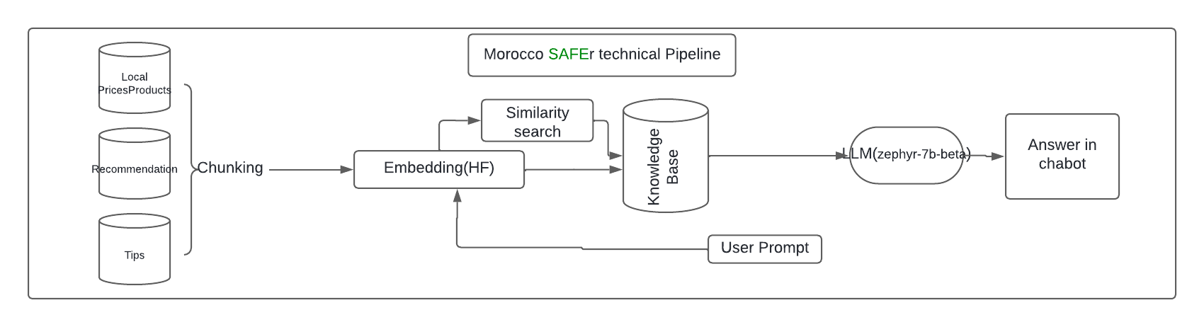
AI-Pipeline

Slide 13
Demo
Link: https://github.com/salmaelbarbori/HAKCATHONAIINSEA

Slide 14
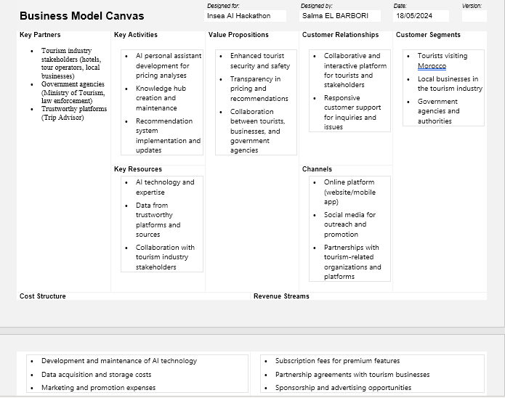
The strategic vision of the project

Slide 15
The strategic vision of the project

Slide 16
Thank you very much!

